Slide 1
Stability test of 2008 COMPASS data
Yanzhao Wang

Slide 2
The goals of analysis
Finding runs with abnormal properties
Individual investigation of the runs
Determine probable cause of abnormal properties

Slide 3
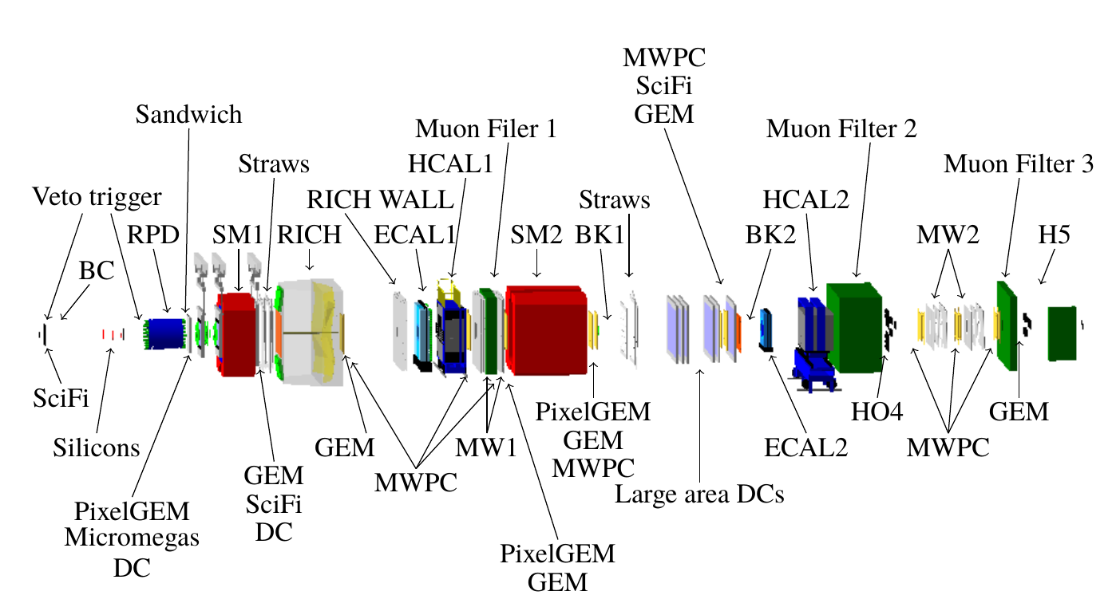
Detector Layout
Target

Slide 4
Structure of data storage
Run Number:
... | 69696 | 69697 | 69698 | ... | ... | 70161 | 70162 | 70163 | ...
Spill Number:
... | 3 | 4 | 5 | ... | ... | 188 | 189 | 190 | ...
Events:
... | event 100 | event 101 | event 102 | ... | ... | event 12001 | event 12002 | event 12003 | ...
Particles, tracks, vertices, recoiled protons...

Slide 5
Datasets and pre-selection:
Datasets info:
Year | 2008
Week | Week 33, 35, 37
Run number | 69595 ~ 70963
Conditions of filtering
A best primary vertex was found
Primary vertex Z-position Z_pv: -200 cm < Z_pv < 160 cm
Exactly one or three charged tracks, leaving the primary vertex
Charge sum of all three tracks = -1

Slide 6
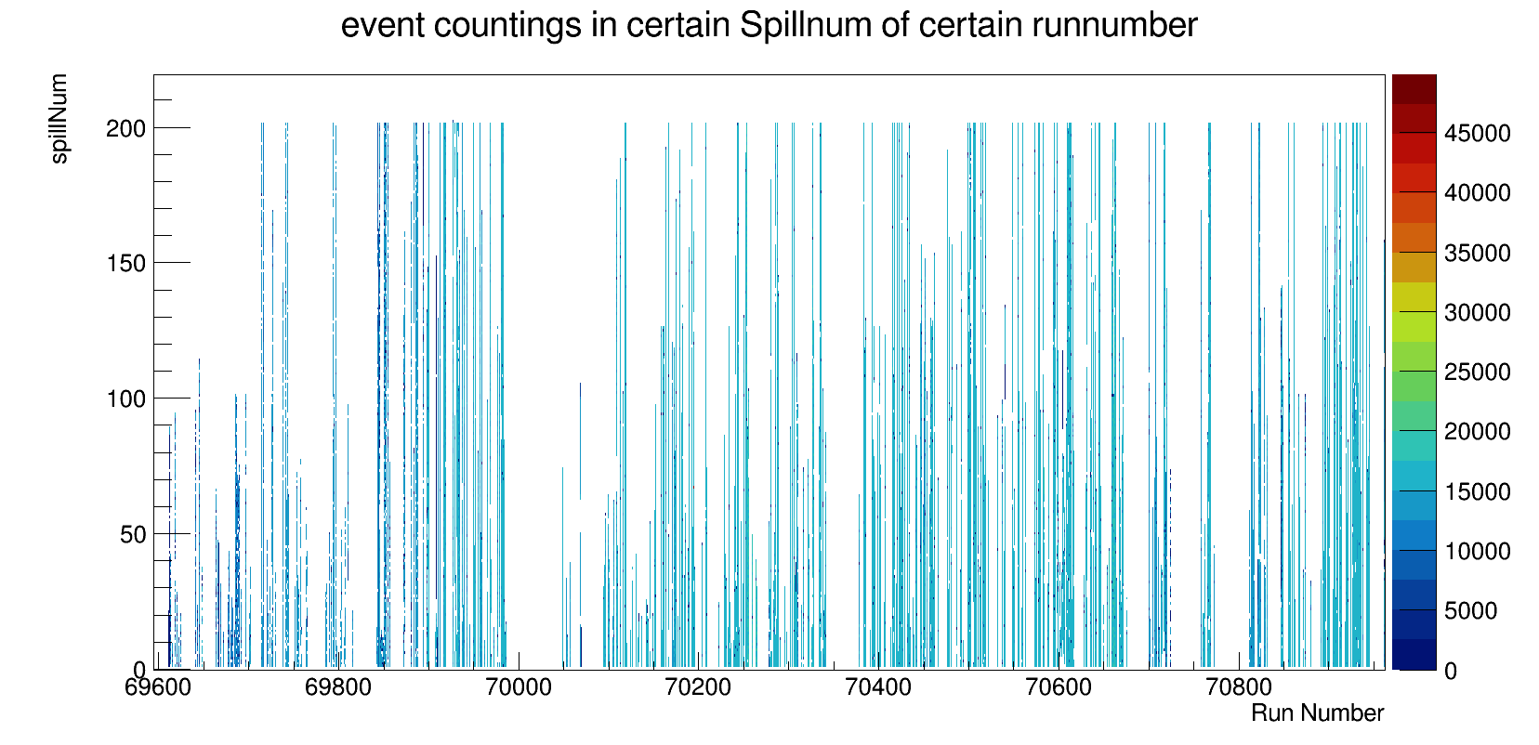
Overlook of event distribution
_{spill number}
_{run number}

Slide 7
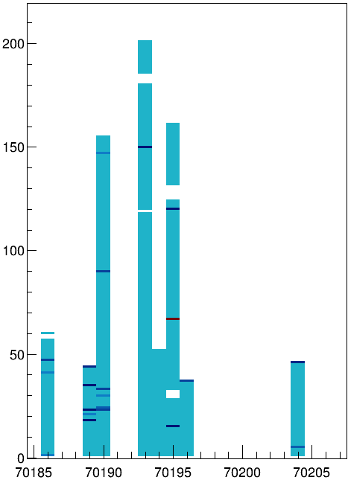
Overlook of event distribution
_{spill number}
_{run number}

Slide 8
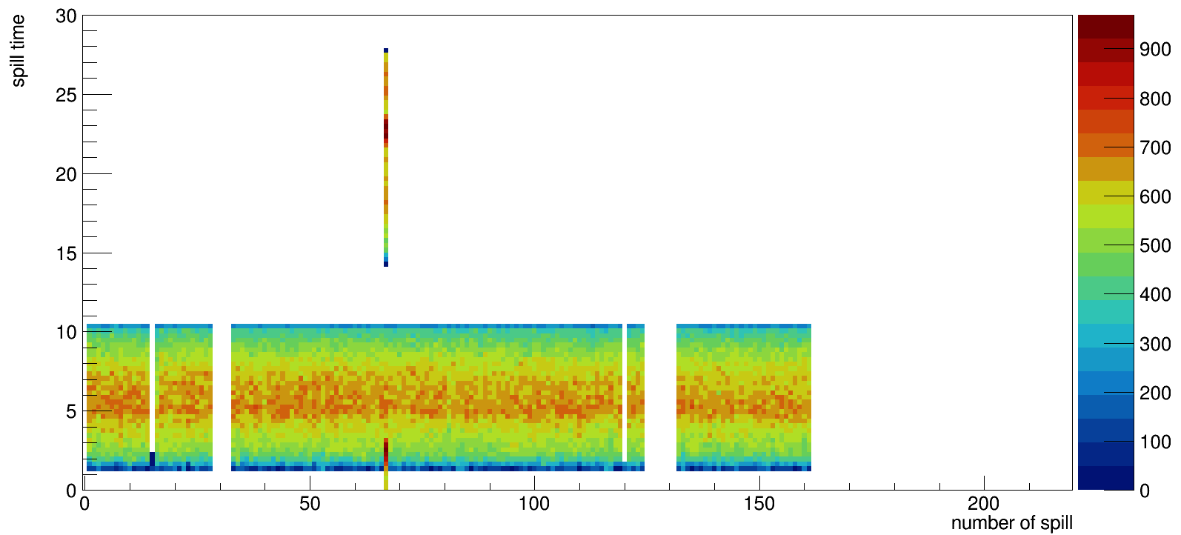
Event distribution of each spill ( Run = 70195)
(sec)
Spill number
_{spill number}

Slide 9
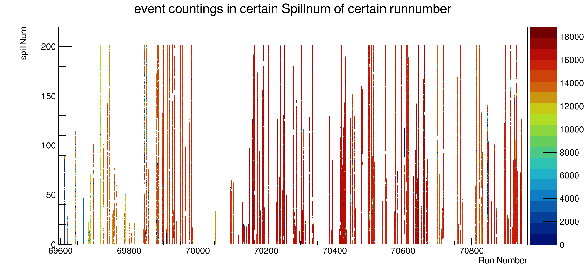
Overlook of event distribution
_{spill number}
_{run number}

Slide 10
Parameters investigated
Invariant mass of three pions
Photon number from different calorimeters
The total invariant mass
Angular distribution of recoiled proton
The FWHM width of invariant mass histogram

Slide 11
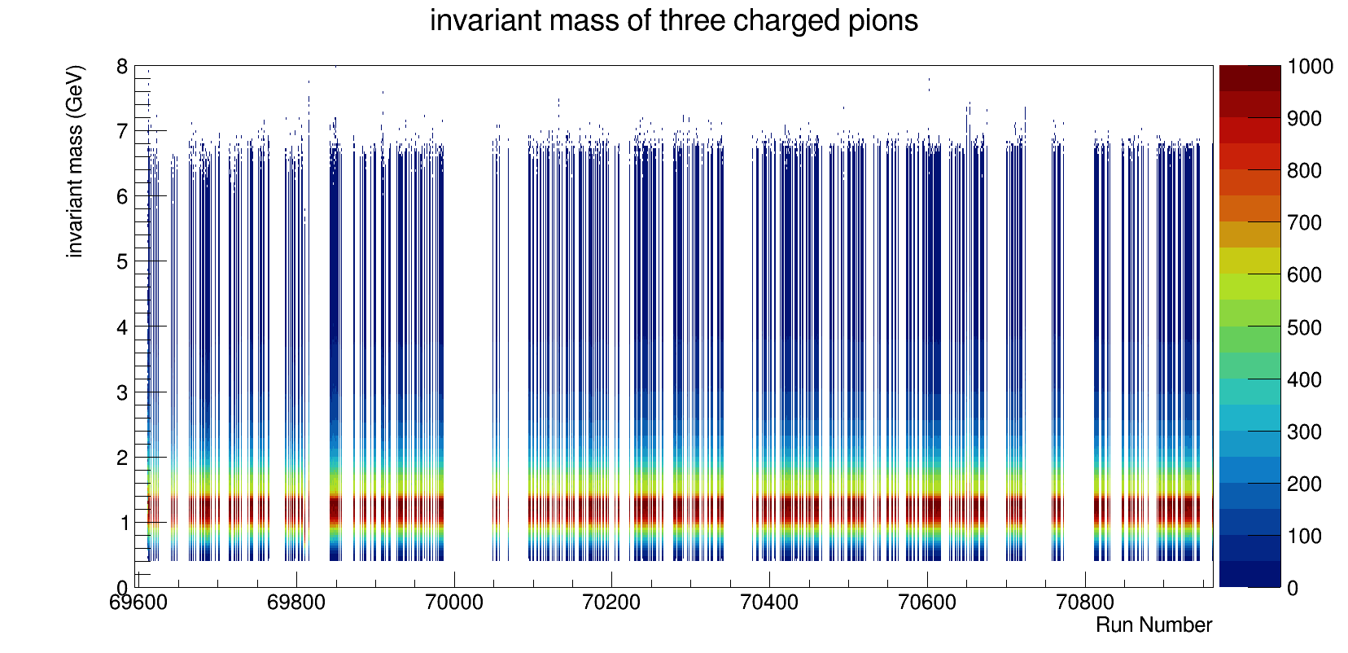
Invariant mass of 3 pions (normalized)
_{run number}

Slide 12
Invariant mass of 3 pions (normalized)
Projection of y at x =69853
_{run number}

Slide 13
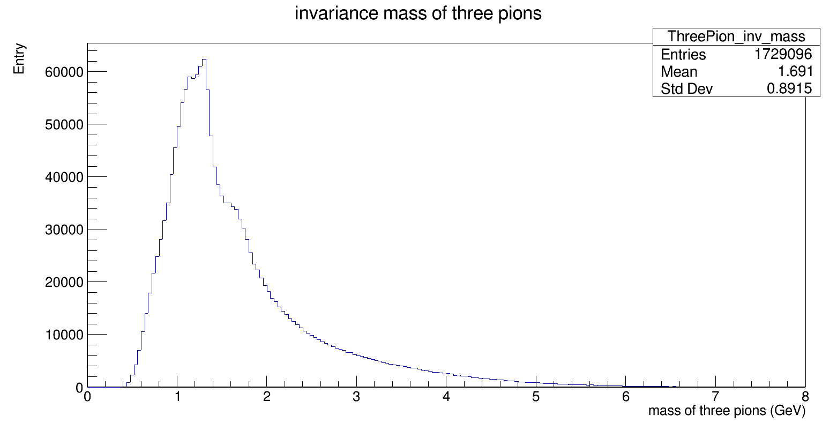
Invariant mass of 3 pions( Run = 69853)
the number of events

Slide 14
Invariant mass of 3 pions( Run = 69853)
the number of events
1.32
1.67

Slide 15
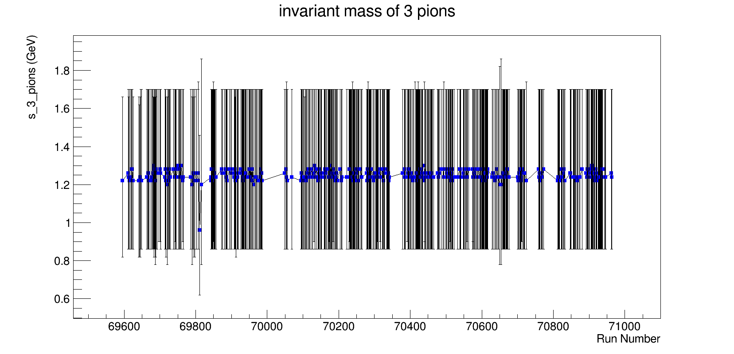
3 pions invariant mass
invariant mass of three pions (GeV)
_{run number}

Slide 16
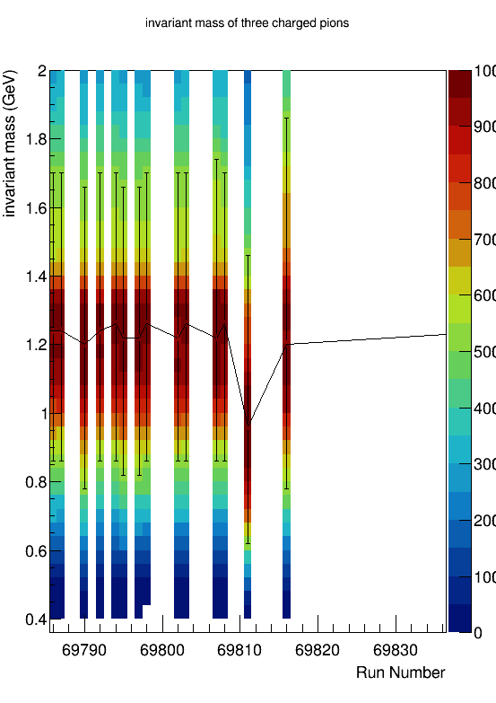
3 pions invariant mass
invariant mass of three pions (GeV)
_{run number}

Slide 17
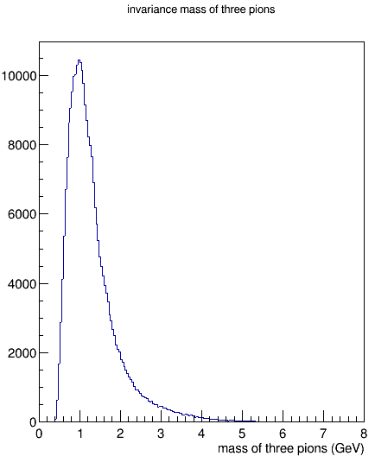
3 pions invariant mass
invariant mass of three pions (GeV)
_{run number}

Slide 18
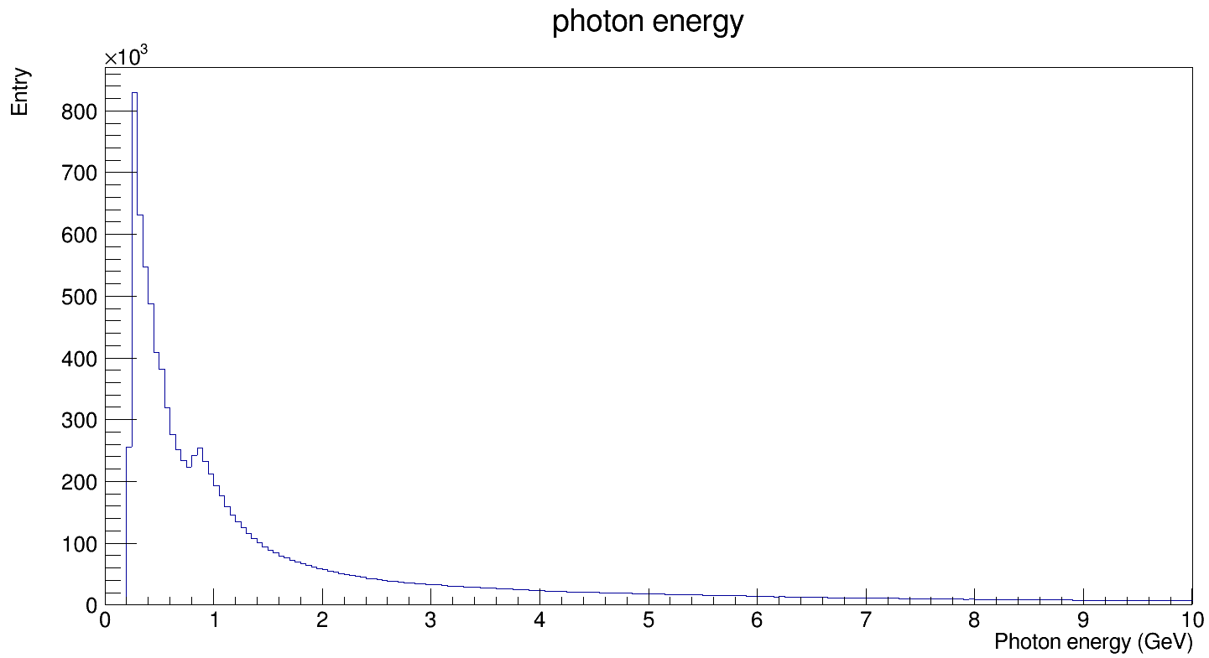
Photon energy ( Run = 69853)
number of photons
the number of events

Slide 19
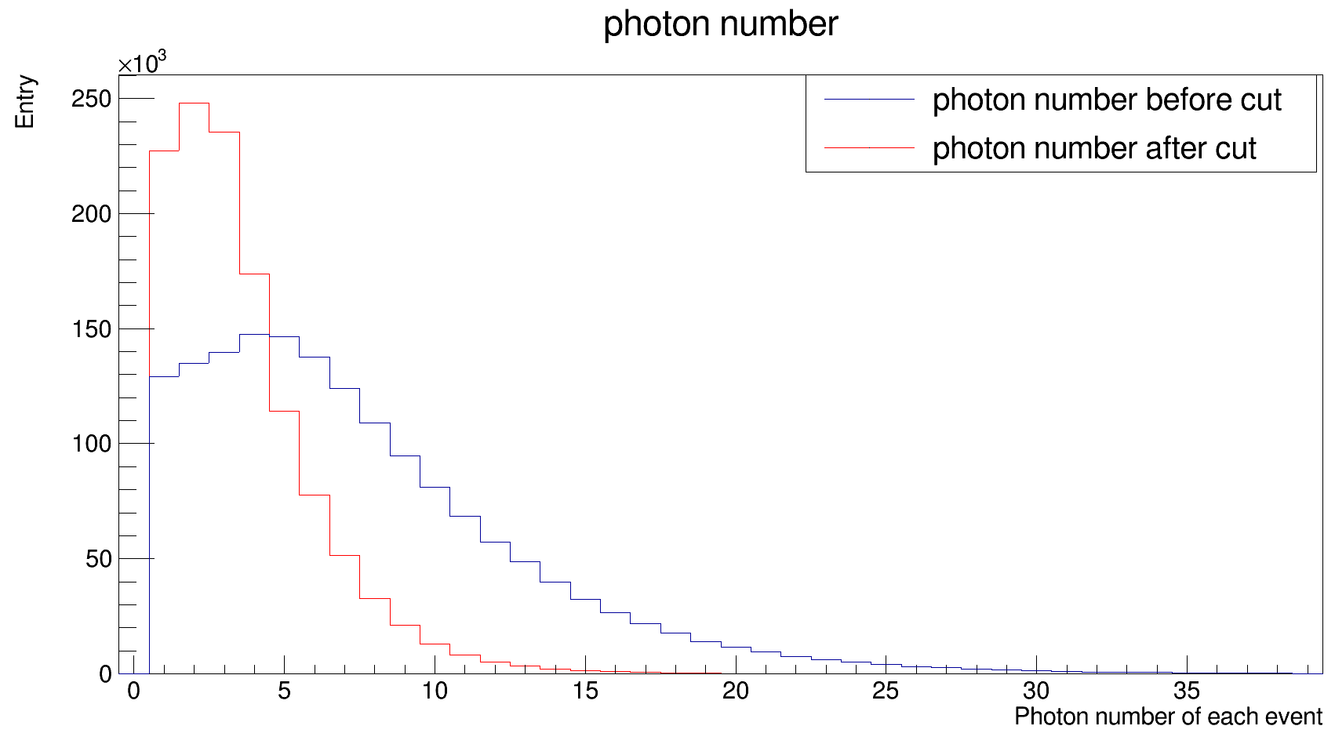
Photon energy cut ( Run = 69853)
the number of events
Cut condition:
Calorimeter | Energy
ECAL1 | >1 GeV
ECAL2 | >4 GeV

Slide 20
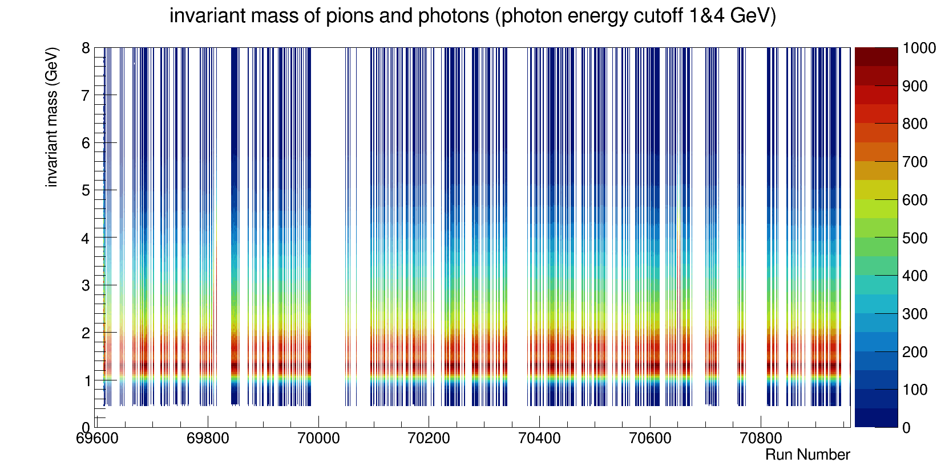
The total invariant mass (normalized)
_{run number}

Slide 21
The total invariant mass (normalized)
Projection of y at x =69853
_{run number}

Slide 22
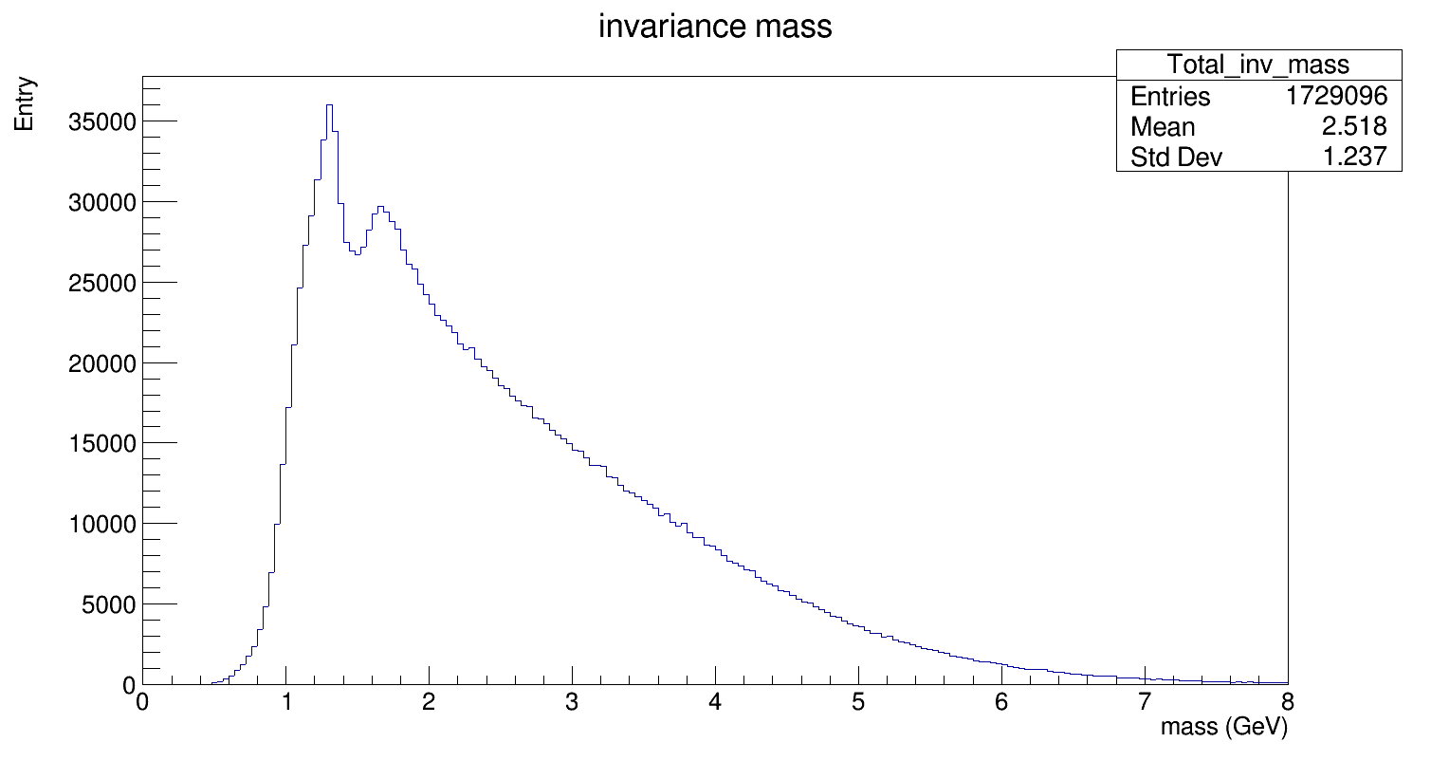
The total invariant mass ( Run = 69853)
the number of events
1.3
1.6

Slide 23
The total invariant mass (normalized)
Projection of y at x =70650
_{run number}

Slide 24
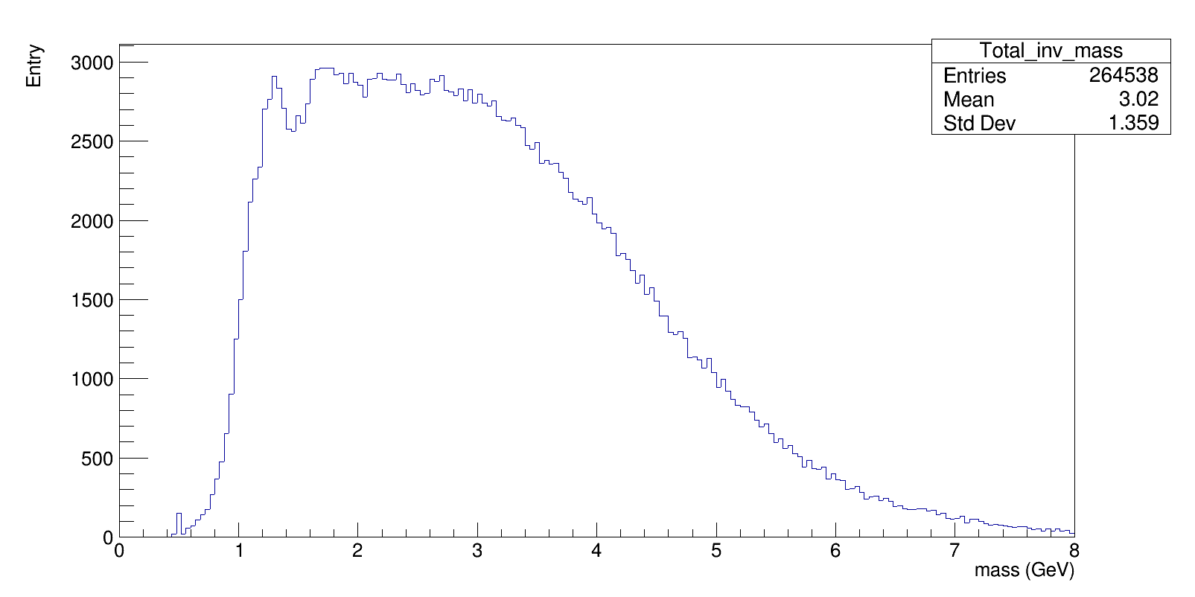
The total invariant mass ( Run = 70650)
the number of events
FWHM ≈ 3.45 GeV

Slide 25
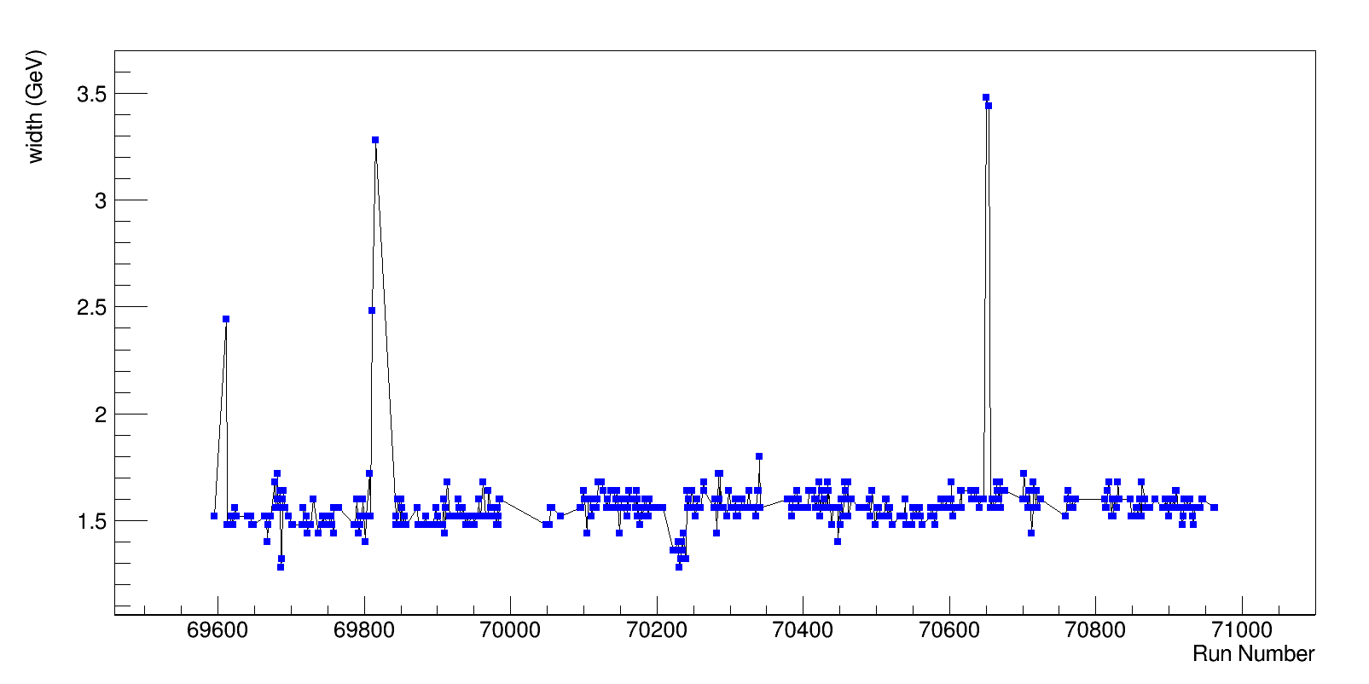
FWHM of total invariant mass
_{run number}

Slide 26
FWHM of total invariant mass
_{run number}

Slide 27
FWHM of total invariant mass
_{run number}

Slide 28
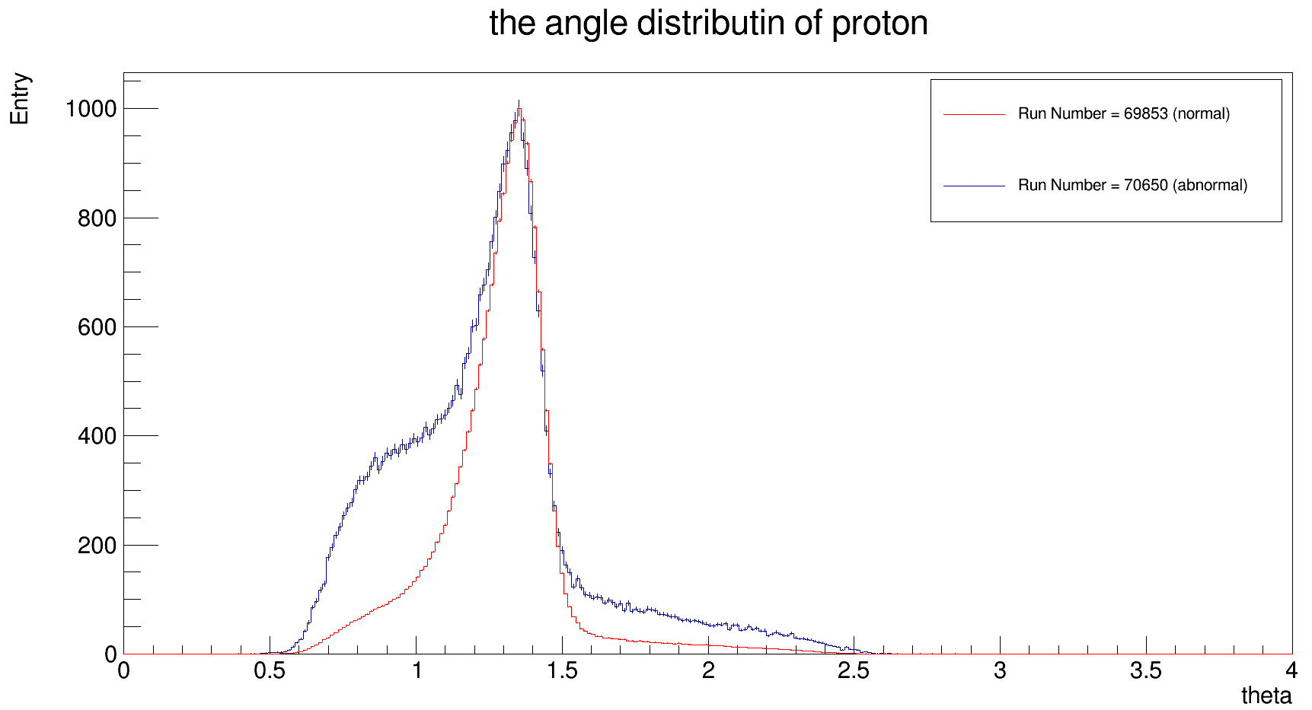
Recoiled Proton angular distribution
the number of events
Width at 23% of maximum
_{theta ( rad )}

Slide 29
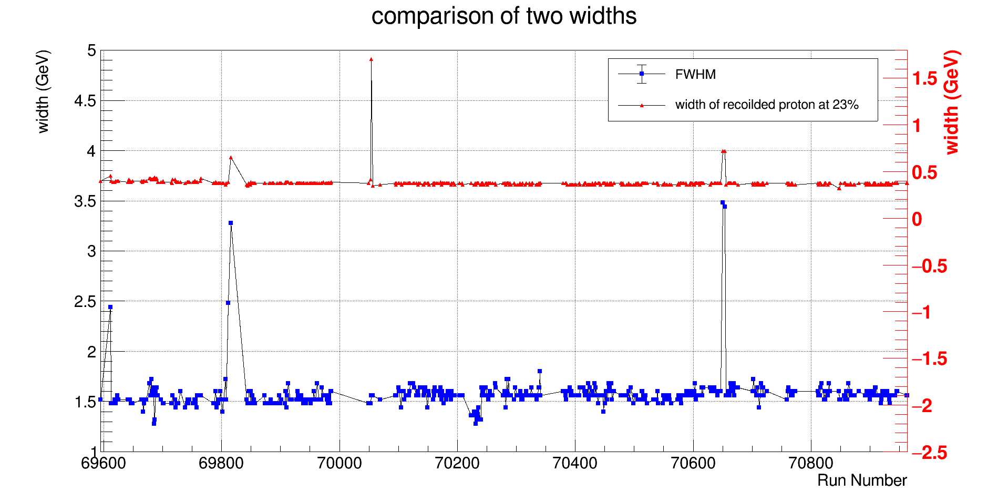
Comparison of widths from invariant mass and angles of recoiled proton
FWHM of invariant mass
_{width ( rad )}
_{run number}

Slide 30
Comparison of widths from invariant mass and angles of recoiled proton
FWHM of invariant mass
_{width ( rad )}
69612
69816
70650 ~ 70654
_{run number}

Slide 31
Comparison of widths from invariant mass and angles of recoiled proton
FWHM of invariant mass
_{width ( rad )}
Run Number: 69811
abnormal three pions mass
69612
69816
70650 ~ 70654
_{run number}

Slide 32
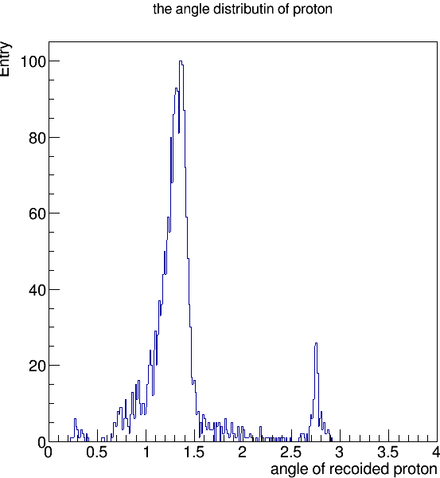
Comparison of widths from invariant mass and angles of recoiled proton
Run Number: 70054
FWHM of invariant mass
_{width ( rad )}
69612
69816
70650 ~ 70654
_{run number}

Slide 33
Comparison of widths from invariant mass and angles of recoiled proton
FWHM of invariant mass
_{width ( rad )}
69612
69816
70650 ~ 70654
_{run number}
70223 ~ 70240

Slide 34
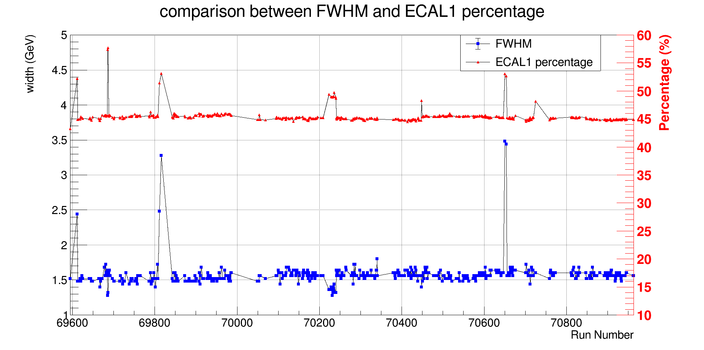
Comparison of ECAL1 percentage and FWHM of invariant mass
FWHM of invariant mass
_{run number}

Slide 35
Comparison of ECAL1 percentage and FWHM of invariant mass
FWHM of invariant mass
69696 ~ 69687
70223 ~ 70240
70448
_{run number}

Slide 36
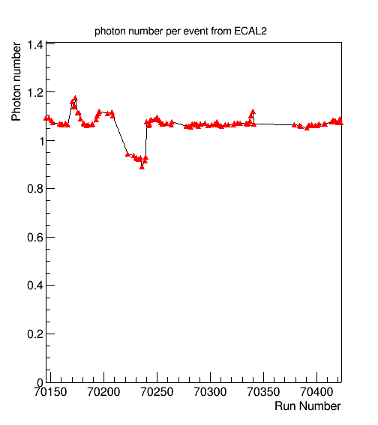
Comparison of ECAL1 percentage and FWHM of invariant mass
69696 ~ 69687
70223 ~ 70240
70448
_{run number}

Slide 37
Summary
Run number | correlated parameter | Log book/Comments
70195 | Disorder of Spill time | Good
69811 | Three pion mass | Magnets were ramped up during run
70054 | Double peaks for recoiled proton | Errors appeared for SrcId
69612 | Recoiled proton angular distribution | N/A
69816 |  | No sandwich veto
70650 |  | Special run to test sandwich veto
70654 |  | No sandwich veto
69696 | Decrease of number of photons from ECAL2 | Detector test
69687 |  | Light trigger problems
70223 ~ 70240 |  | High voltage trip on ECAL2
70448 |  | Low intensity beam

Slide 38
End

